Slide 1
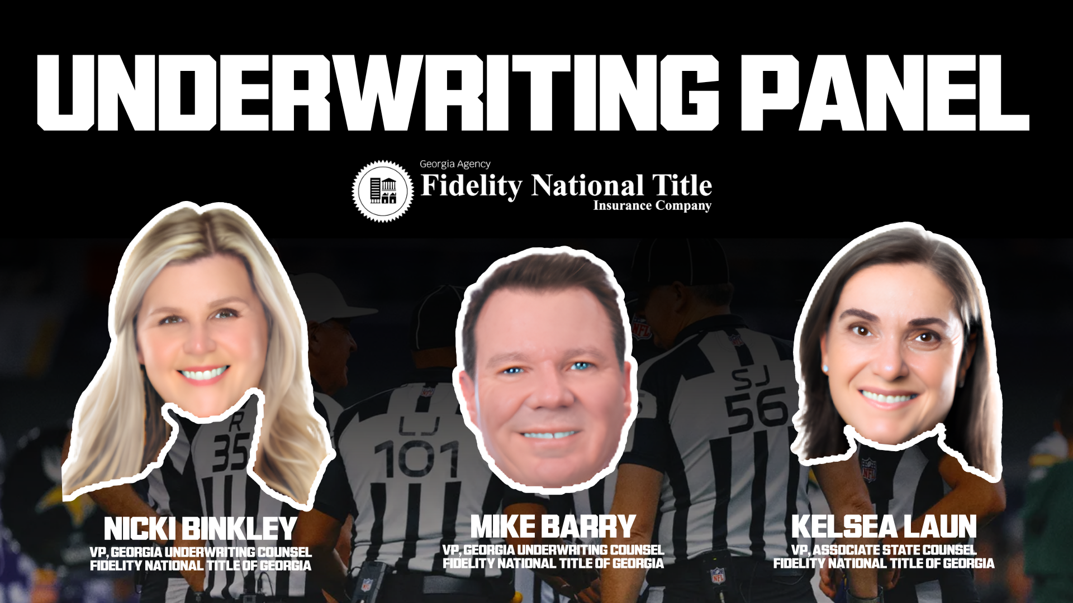

Slide 2


NEXT MATCHUP
SALE OR REFINANCE OF PROPERTY FOLLOWING A DIVORCE
UNDERWRITING PANEL | TITLE TAILGATE
Notes:
[Sources]
Source content: 2026 Title Tailgage CLE UW Panel Slides - combined.docx
[/Sources]

Slide 3
TITLE TAILGATE
UNDERWRITING GUIDANCE
The seller of this property divorced in 2023. At the time, the seller was the only one on title, and the property was not the marital residence. The settlement agreement notes that the seller shall have full right title and interest in the property, and that it is free and clear of any claims from the wife. “Wife hereby quitclaims any interest she may have in this property in favor of Husband and upon entry of this Agreement, Wife is divested of any interest in this property.”
Notes:
[Sources]
Source content: 2026 Title Tailgage CLE UW Panel Slides - combined.docx
[/Sources]

Slide 4
MAKE THE CALL
What is your call?
INSURE
DON’T INSURE
NEED MORE INFORMATION
VOTE BEFORE THE RULING
Notes:
[Sources]
Source content: 2026 Title Tailgage CLE UW Panel Slides - combined.docx
[/Sources]

Slide 5
TITLE TAILGATE
UNDERWRITING GUIDANCE
Insure. In this scenario, we don’t need any additional deeds out of the wife since the settlement agreement explicitly says that she hereby quitclaims any interest she has in the property. The specific language in the order allows us to rely upon the order itself as the conveyance divesting her of title.
Notes:
[Sources]
Source content: 2026 Title Tailgage CLE UW Panel Slides - combined.docx
[/Sources]

Slide 6
TITLE TAILGATE
UNDERWRITING GUIDANCE
Consider though, if the settlement agreement only said that the husband is awarded possession and use, or states that the wife has no interest in the property, that is not always enough. A quitclaim deed out of the wife may be required and underwriting review should be requested.
Notes:
[Sources]
Source content: 2026 Title Tailgage CLE UW Panel Slides - combined.docx
[/Sources]

Slide 7
TITLE TAILGATE
UNDERWRITING GUIDANCE
Consider also if both spouses are on title. The language in the divorce settlement and decree is sometimes sufficient to convey title but should not be relied upon to do so without underwriting approval. The language in the example given today would likely be sufficient for us to rely upon a recordation of the settlement agreement and divorce decree to insure without a separate quitclaim deed.
Notes:
[Sources]
Source content: 2026 Title Tailgage CLE UW Panel Slides - combined.docx
[/Sources]

Slide 8
NEXT MATCHUP
MATERIALMAN’S LIENS
UNDERWRITING PANEL | TITLE TAILGATE
Notes:
[Sources]
Source content: 2026 Title Tailgage CLE UW Panel Slides - combined.docx
[/Sources]

Slide 9
TITLE TAILGATE
SCENARIO
The title exam revealed a Notice of Commencement dated July 29, 2026. Can we insure without a release?
Notes:
[Sources]
Source content: 2026 Title Tailgage CLE UW Panel Slides - combined.docx
[/Sources]

Slide 10
MAKE THE CALL
What is your call?
INSURE
DON’T INSURE
NEED MORE INFORMATION
VOTE BEFORE THE RULING
Notes:
[Sources]
Source content: 2026 Title Tailgage CLE UW Panel Slides - combined.docx
[/Sources]

Slide 11
TITLE TAILGATE
UNDERWRITING GUIDANCE
Need more information. In this scenario, it is possible that work has already started on the property. Contractors may file a Notice of Commencement prior to closing before any work has been done, or it could be an indication that work has started.
Notes:
[Sources]
Source content: 2026 Title Tailgage CLE UW Panel Slides - combined.docx
[/Sources]

Slide 12
TITLE TAILGATE
UNDERWRITING GUIDANCE
If work has started prior to closing, then certain requirements need to be met in order to provide any mechanic’s lien coverage, including lien waivers, subordinations, contractor affidavits and indemnity.
Notes:
[Sources]
Source content: 2026 Title Tailgage CLE UW Panel Slides - combined.docx
[/Sources]

Slide 13
TITLE TAILGATE
UNDERWRITING GUIDANCE
What if, instead of a notice of commencement, the title examination reveals a recorded contractor's invoice marked “unpaid” and dated more than one year prior to the examination date.
Notes:
[Sources]
Source content: 2026 Title Tailgage CLE UW Panel Slides - combined.docx
[/Sources]

Slide 14
MAKE THE CALL
What is your call?
INSURE
DON’T INSURE
NEED MORE INFORMATION
VOTE BEFORE THE RULING
Notes:
[Sources]
Source content: 2026 Title Tailgage CLE UW Panel Slides - combined.docx
[/Sources]

Slide 15
UNDERWRITING PANEL
Need more information:
Materialmen’s liens present a significant “hidden lien” risk in Georgia because lien rights may arise from labor, services, or materials furnished even where no lien claim or notice of commencement has been filed of record. Georgia law grants contractors, subcontractors, laborers, and suppliers a statutory lien against the property improved, and lien priority generally relates back to the commencement of visible work on the property.
Notes:
[Sources]
Source content: 2026 Title Tailgage CLE UW Panel Slides - combined.docx
[/Sources]

Slide 16
TITLE TAILGATE
UNDERWRITING GUIDANCE
A recorded document does not necessarily create an enforceable lien, and there are clear deadlines in Georgia for filing a Claim of Lien (90 days after furnishing labor or materials) and initiating an enforcement action within the statutory period. However, we may require clearance of an instrument of record or other potential cloud on title even where the instrument would be deemed invalid or void if challenged in court because to insure without exception to the matter would put us in the position of potentially paying for litigation if the claimant were to attempt enforcement. Even where an instrument may be expired, we may require further action if the claimant has contacted the closing firm or seller demanding payment or asserting that the lien is valid. One issue is that not all contractors are well-versed on the laws of mechanic’s liens and may attempt to enforce an invalid or expired lien. We don’t typically insure with known potential defense costs looming.
Notes:
[Sources]
Source content: 2026 Title Tailgage CLE UW Panel Slides - combined.docx
[/Sources]

Slide 17
TITLE TAILGATE
UNDERWRITING GUIDANCE
When insuring Georgia construction transactions, do not rely solely on the public records. The primary underwriting concern is whether unpaid labor or materials have been furnished to the property within the statutory lien period. A combination of title search review, construction status verification, contractor/owner affidavits, and properly executed lien waivers is typically the most effective method of mitigating materialmen’s lien risk.
Notes:
[Sources]
Source content: 2026 Title Tailgage CLE UW Panel Slides - combined.docx
[/Sources]

Slide 18
NEXT MATCHUP
PENDING LITIGATION
UNDERWRITING PANEL | TITLE TAILGATE
Notes:
[Sources]
Source content: 2026 Title Tailgage CLE UW Panel Slides - combined.docx
[/Sources]

Slide 19
TITLE TAILGATE
UNDERWRITING GUIDANCE
Title exam revealed an open lawsuit between our seller (defendant) and a neighbor (plaintiff), where the neighbor has alleged damage to their property. The lawsuit is to pursue recovery for damages and equitable relief. No final order has been filed yet.
Notes:
[Sources]
Source content: 2026 Title Tailgage CLE UW Panel Slides - combined.docx
[/Sources]

Slide 20
MAKE THE CALL
What is your call?
INSURE
DON’T INSURE
NEED MORE INFORMATION
VOTE BEFORE THE RULING
Notes:
[Sources]
Source content: 2026 Title Tailgage CLE UW Panel Slides - combined.docx
[/Sources]

Slide 21
TITLE TAILGATE
UNDERWRITING GUIDANCE
Need more information. As a general rule, we can’t insure title to property where the title is subject to active litigation. In the facts presented, the pending suit involves a claim for damages that may result in an eventual monetary judgment and FiFa, but there is no specific claim of interest in the property itself. If no Lis Pendens has been filed, we may be able to insure without action regarding the subject lawsuit. When presenting a transaction involving litigation to underwriting for review, it is helpful to share whether a lis pendens been filed and whether the plaintiff is seeking an interest in the property (such as with wrongful eviction, claims for easements, enforcement of prior contracts for sale or lease).
Notes:
[Sources]
Source content: 2026 Title Tailgage CLE UW Panel Slides - combined.docx
[/Sources]

Slide 22
NEXT MATCHUP
WILD CLAIMS OF INTEREST
UNDERWRITING PANEL | TITLE TAILGATE
Notes:
[Sources]
Source content: 2026 Title Tailgage CLE UW Panel Slides - combined.docx
[/Sources]

Slide 23
TITLE TAILGATE
UNDERWRITING GUIDANCE
Title exam revealed a writ filed by a former tenant claiming to hold an interest in the property. The seller filed a quiet title action seeking to void the writ and that action is pending.
Notes:
[Sources]
Source content: 2026 Title Tailgage CLE UW Panel Slides - combined.docx
[/Sources]

Slide 24
MAKE THE CALL
What is your call?
INSURE
DON’T INSURE
NEED MORE INFORMATION
VOTE BEFORE THE RULING
Notes:
[Sources]
Source content: 2026 Title Tailgage CLE UW Panel Slides - combined.docx
[/Sources]

Slide 25
TITLE TAILGATE
UNDERWRITING GUIDANCE
Need more information. In the scenario above, we would need more information including the status of the litigation, the basis for the tenant’s claim, and status of possession. Regardless of the merits of the tenant’s claim, to insure without exception or resolution would arguably be insuring losses related to the pending litigation. For us to insure without exception, we would require either a final court order declaring the writ void and ineffective or, alternatively, a quitclaim deed of release from the tenant and dismissal of the quiet title action.
Notes:
[Sources]
Source content: 2026 Title Tailgage CLE UW Panel Slides - combined.docx
[/Sources]

Slide 26
TITLE TAILGATE
UNDERWRITING GUIDANCE
We also see affidavits of interest, or other affidavits of record where a former potential buyer claims a right to purchase the property under a prior purchase and sale agreement. Insuring without exception to such matters of record requires underwriting review to determine if a release is required. We consider factors such as how long ago the instrument was filed, if there is an expiration date, and the terms of the instrument.
Notes:
[Sources]
Source content: 2026 Title Tailgage CLE UW Panel Slides - combined.docx
[/Sources]

Slide 27
NEXT MATCHUP
FOREIGN NOTARY
UNDERWRITING PANEL | TITLE TAILGATE
Notes:
[Sources]
Source content: 2026 Title Tailgage CLE UW Panel Slides - combined.docx
[/Sources]

Slide 28
TITLE TAILGATE
UNDERWRITING GUIDANCE
Husband would like to transfer a few properties to his wife. The wife just informed us that the husband visiting family in Turkey. Wife is asking if husband can have the deed notarized in Turkey.
Notes:
[Sources]
Source content: 2026 Title Tailgage CLE UW Panel Slides - combined.docx
[/Sources]

Slide 29
MAKE THE CALL
What is your call?
YES
NO
NEED MORE INFORMATION
VOTE BEFORE THE RULING
Notes:
[Sources]
Source content: 2026 Title Tailgage CLE UW Panel Slides - combined.docx
[/Sources]

Slide 30
TITLE TAILGATE
UNDERWRITING GUIDANCE
Yes. In this scenario, the husband can sign the deed with a local notary in Turkey and have it certified with an apostille. Notarization alone is not sufficient when the principal is in a foreign country. However, if the foreign country is part of the Hague Apostille Convention, then we can accept a local notary with an apostille. If the country is not a member of the Hague Apostille Convention or is subject to ongoing political unrest and/or crime, we may require notarization at the U.S. Embassy. If you are unsure as to whether an Apostille is sufficient, please reach out to underwriting counsel for assistance.
GSCCCA maintains a list of countries that are participants of the Apostille Convention (Hague Treaty Convention 12).
Notes:
[Sources]
Source content: 2026 Title Tailgage CLE UW Panel Slides - combined.docx
[/Sources]

Slide 31
UNDERWRITING PANEL
What is an Apostille?
An apostille is an official government certificate that verifies the authenticity of a signature, seal, or stamp on a public document so it can be recognized in another country.
It confirms that the official or notary public who signed the document is genuine and holds a valid commission
Notes:
[Sources]
Source content: 2026 Title Tailgage CLE UW Panel Slides - combined.docx
[/Sources]

Slide 32
TITLE TAILGATE
SCENARIO
Any difference if the husband instead wants to sign a Power of Attorney giving an unrelated third-party power to sign for him as his attorney-in-fact?
Notes:
[Sources]
Source content: 2026 Title Tailgage CLE UW Panel Slides - combined.docx
[/Sources]

Slide 33
TITLE TAILGATE
SCENARIO
The same guidelines apply for execution of a POA as with a deed. However, the local notary will likely use their own customary notary form. Caution should be taken to ensure the POA form includes the necessary powers and is adequately executed. The following slide contains a sample Turkish Power of Attorney.
Notes:
[Sources]
Source content: 2026 Title Tailgage CLE UW Panel Slides - combined.docx
[/Sources]

Slide 34
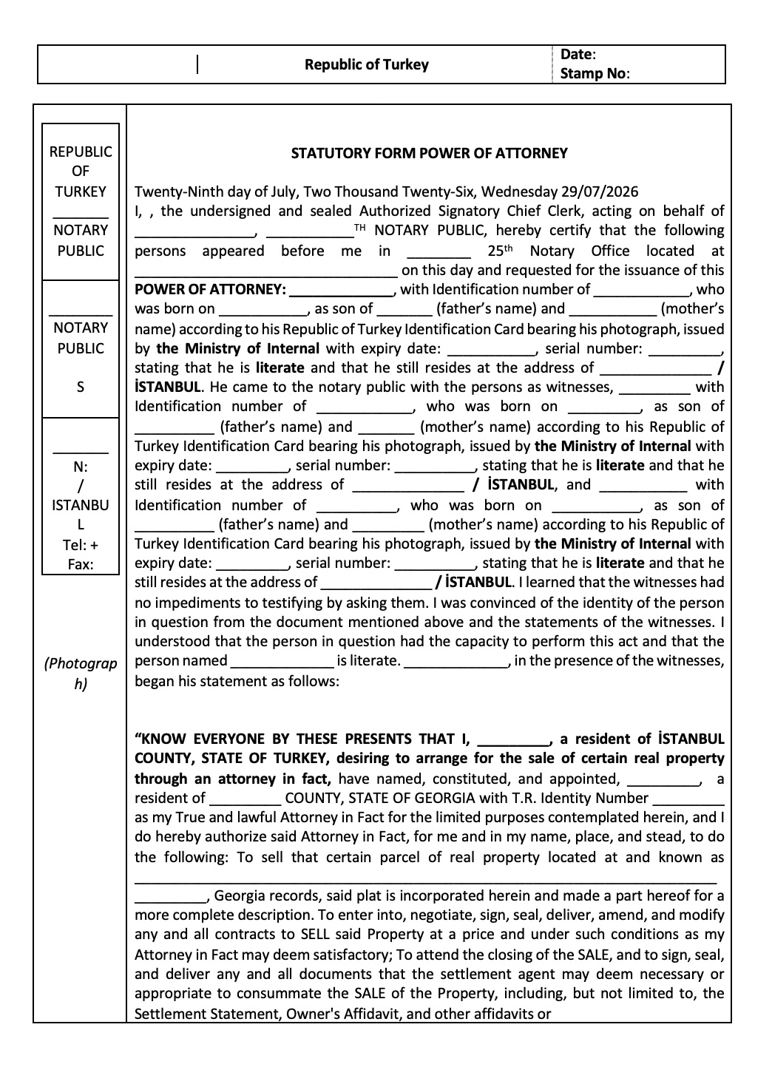
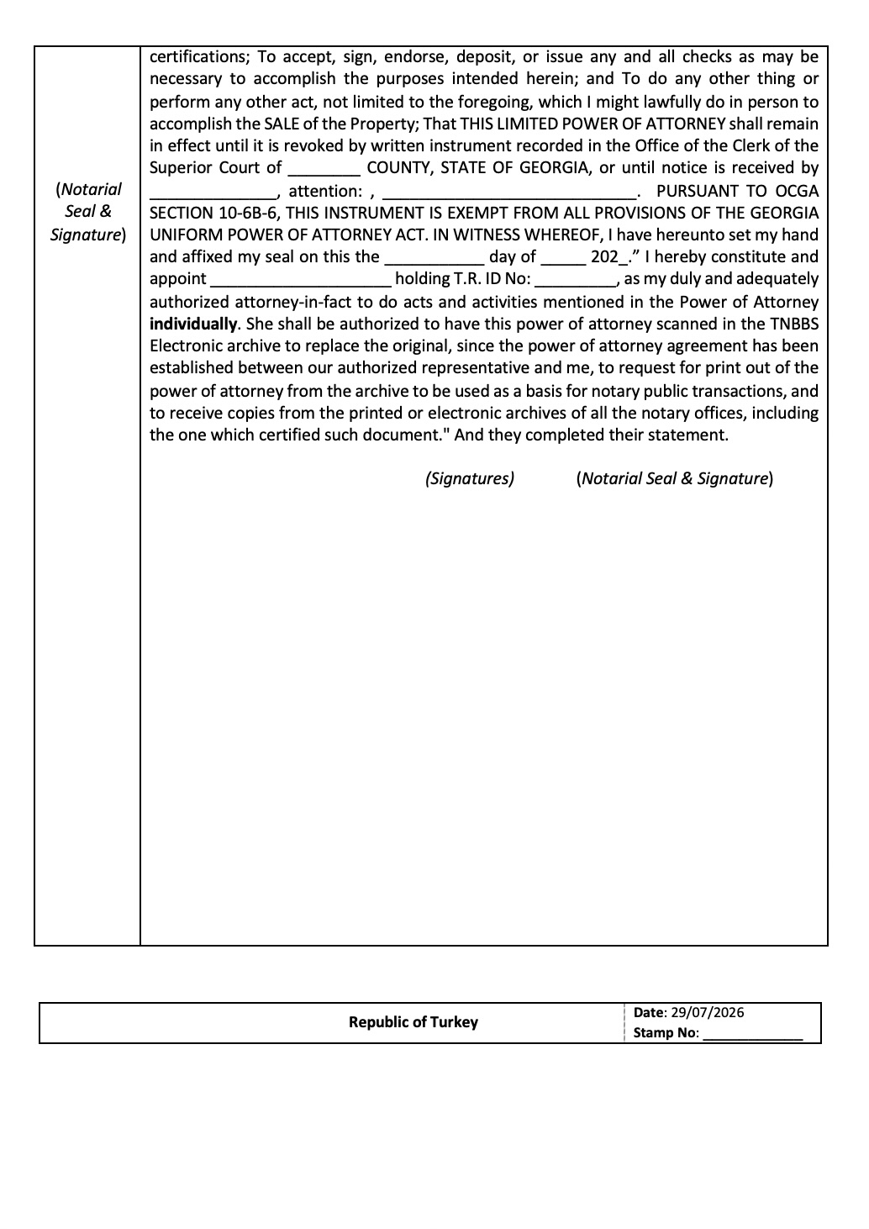
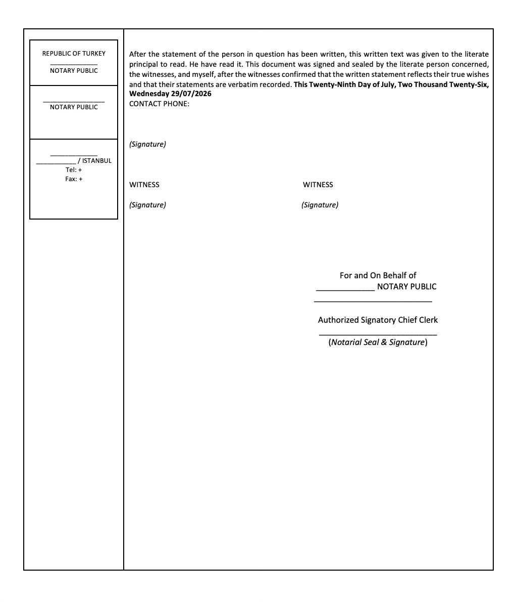
FOREIGN NOTARY
Sample Turkey Power of Attorney
Notes:
[Sources]
Source content: 2026 Title Tailgage CLE UW Panel Slides - combined.docx
[/Sources]

Slide 35
NEXT MATCHUP
TRUSTS
UNDERWRITING PANEL | TITLE TAILGATE
Notes:
[Sources]
Source content: 2026 Title Tailgage CLE UW Panel Slides - combined.docx
[/Sources]

Slide 36
UNDERWRITING PANEL
Trusts
Transaction involves the sale of property currently vested in Susie Seller as Trustee of the Susie Seller Family Revocable Trust UTD September 1, 2020. Susie Seller is deceased and the purported successor trustee has contracted to sell the property to the proposed insured buyer.
Notes:
[Sources]
Source content: 2026 Title Tailgage CLE UW Panel Slides - combined.docx
[/Sources]

Slide 37
MAKE THE CALL
What is your call?
INSURE
DON’T INSURE
NEED MORE INFORMATION
VOTE BEFORE THE RULING
Notes:
[Sources]
Source content: 2026 Title Tailgage CLE UW Panel Slides - combined.docx
[/Sources]

Slide 38
TITLE TAILGATE
UNDERWRITING GUIDANCE
Need more information. When title is vested in a trust, the title insurer's primary objective is to confirm that the trust exists, the trustee has powers to act on behalf of the trust, and the proposed transaction is authorized under the trust documents.
Notes:
[Sources]
Source content: 2026 Title Tailgage CLE UW Panel Slides - combined.docx
[/Sources]

Slide 39
TITLE TAILGATE
UNDERWRITING GUIDANCE
Our focus in reviewing a trust is on authority, capacity, title continuity, and beneficiary-related risks rather than the trust's substantive estate-planning provisions.
Notes:
[Sources]
Source content: 2026 Title Tailgage CLE UW Panel Slides - combined.docx
[/Sources]

Slide 40
UNDERWRITING PANEL
Core Underwriting Review – 1
Confirm the Trust's Existence and Identity
Verify the exact name of the trust as title is vested.
Determine whether the trust is revocable or irrevocable.
Confirm the date of the trust and any amendments.
Ensure the vesting deed matches the current trust and trustee information.
Notes:
[Sources]
Source content: 2026 Title Tailgage CLE UW Panel Slides - combined.docx
[/Sources]

Slide 41
UNDERWRITING PANEL
Core Underwriting Review – 2
Verify Trustee Authority
Review the trust agreement or a valid certification of trust.
Confirm the current trustee has authority to:
  acquire, convey, mortgage, or lease property;
  execute loan documents;
  delegate authority (if applicable).
If multiple trustees serve, determine whether they may act independently or must act jointly.
Notes:
[Sources]
Source content: 2026 Title Tailgage CLE UW Panel Slides - combined.docx
[/Sources]

Slide 42
UNDERWRITING PANEL
Core Underwriting Review – 3
Review Title Chain
Confirm title was properly conveyed into the trust.
Check for any gaps caused by trustee deaths, resignations, or successor trustee appointments.
Notes:
[Sources]
Source content: 2026 Title Tailgage CLE UW Panel Slides - combined.docx
[/Sources]

Slide 43
UNDERWRITING PANEL
Death or Incapacity Concerns
If the trust creator or trustee has died:
Obtain evidence of death.
Verify successor trustee appointment procedures were followed.
Confirm acceptance of trusteeship by the successor trustee.
Determine whether trust powers changed upon death.
Notes:
[Sources]
Source content: 2026 Title Tailgage CLE UW Panel Slides - combined.docx
[/Sources]

Slide 44
UNDERWRITING PANEL
Certification of Trust
We are often asked if we can rely upon a certification of trust executed a significant amount of time prior to closing or even executed in conjunction with the signing of the trust itself. Unless the original settlors are identified as the initial trustees and serving as the trustees in the sale, we will require a certificate of trust signed in conjunction with closing.
The certificate should include:
trust name and date;
trustee identity;
trustee powers;
revocability status; and
authority to enter the transaction.
Notes:
[Sources]
Source content: 2026 Title Tailgage CLE UW Panel Slides - combined.docx
[/Sources]

Slide 45
UNDERWRITING PANEL
Non-exclusive checklist when reviewing a trust:
☐ Trust exists and is properly named.
☐ Trustee identity is verified.
☐ Trustee has authority to act.
☐ Successor trustee appointments are valid.
☐ Title was properly conveyed into the trust.
☐ No beneficiary consent requirements remain unsatisfied.
☐ No trust restrictions prohibit the transaction.
☐ Execution blocks correctly reflect fiduciary capacity.
☐ All amendments affecting authority have been reviewed.
☐ Any lender-specific trust requirements have been satisfied.
Notes:
[Sources]
Source content: 2026 Title Tailgage CLE UW Panel Slides - combined.docx
[/Sources]

Slide 46
NEXT MATCHUP
BANKRUPTCY
UNDERWRITING PANEL | TITLE TAILGATE
Notes:
[Sources]
Source content: 2026 Title Tailgage CLE UW Panel Slides - combined.docx
[/Sources]

Slide 47
UNDERWRITING PANEL
Insuring transactions involving sellers or borrowers in an active bankruptcy
Seller is in an active bankruptcy case.
Can you proceed to closing?
Notes:
[Sources]
Source content: 2026 Title Tailgage CLE UW Panel Slides - combined.docx
[/Sources]

Slide 48
MAKE THE CALL
What is your call?
INSURE
DON’T INSURE
NEED MORE INFORMATION
VOTE BEFORE THE RULING
Notes:
[Sources]
Source content: 2026 Title Tailgage CLE UW Panel Slides - combined.docx
[/Sources]

Slide 49
TITLE TAILGATE
UNDERWRITING GUIDANCE
Yes, with court approval. Real property can be sold by a debtor during a pending bankruptcy case, but the sale generally cannot occur without complying with bankruptcy court requirements. When a bankruptcy petition is filed, an automatic stay arises under 11 U.S.C. § 362, and the property typically becomes part of the bankruptcy estate. As a result, the debtor's ability to sell real property is restricted and subject to the bankruptcy process. Our underwriting requirements vary depending on the chapter under which the bankruptcy case is filed:
Notes:
[Sources]
Source content: 2026 Title Tailgage CLE UW Panel Slides - combined.docx
[/Sources]

Slide 50
TITLE TAILGATE
UNDERWRITING GUIDANCE
Chapter 7: The bankruptcy trustee generally controls non-exempt assets of the estate. A sale of real property usually requires notice to creditors and approval of the bankruptcy court under 11 U.S.C. § 363. Proceeds are distributed according to bankruptcy priorities.
Notes:
[Sources]
Source content: 2026 Title Tailgage CLE UW Panel Slides - combined.docx
[/Sources]

Slide 51
TITLE TAILGATE
UNDERWRITING GUIDANCE
Chapter 11: The debtor-in-possession may seek court approval to sell real property, often through a sale motion under § 363. The court evaluates whether the sale serves a valid business purpose and protects creditor interests.
Notes:
[Sources]
Source content: 2026 Title Tailgage CLE UW Panel Slides - combined.docx
[/Sources]

Slide 52
TITLE TAILGATE
UNDERWRITING GUIDANCE
Chapter 13: Although the debtor generally retains possession of property, the debtor must ordinarily obtain bankruptcy court approval before selling real estate. The proceeds may be subject to the Chapter 13 plan and creditor claims.
Notes:
[Sources]
Source content: 2026 Title Tailgage CLE UW Panel Slides - combined.docx
[/Sources]

Slide 53
TITLE TAILGATE
UNDERWRITING GUIDANCE
Pocket version: Confirmation as to whether a bankruptcy case is pending, review of any orders authorizing the sale, determination of who has authority to convey title (trustee, debtor-in-possession, or debtor), and compliance with the terms of any related bankruptcy court order.
Notes:
[Sources]
Source content: 2026 Title Tailgage CLE UW Panel Slides - combined.docx
[/Sources]

Slide 54
UNDERWRITING PANEL
Relying on bankruptcy discharge to resolve liens
The title search reveals a FiFa entered against the seller 7 years ago, but Seller argues the FiFa was wiped out by their bankruptcy discharge 5 years ago. Can we rely upon the bankruptcy discharge to insure without a release of the FiFa?
Notes:
[Sources]
Source content: 2026 Title Tailgage CLE UW Panel Slides - combined.docx
[/Sources]

Slide 55
MAKE THE CALL
What is your call?
INSURE
DON’T INSURE
NEED MORE INFORMATION
VOTE BEFORE THE RULING
Notes:
[Sources]
Source content: 2026 Title Tailgage CLE UW Panel Slides - combined.docx
[/Sources]

Slide 56
TITLE TAILGATE
UNDERWRITING GUIDANCE
Need more information. A bankruptcy discharge eliminates the debtor’s personal responsibility to pay the lien and prevents the creditor from collecting directly from the debtor, but a bankruptcy discharge does not transfer title, release valid liens, or terminate interests affecting title without affirmative action taken by way of motion and order.
Notes:
[Sources]
Source content: 2026 Title Tailgage CLE UW Panel Slides - combined.docx
[/Sources]

Slide 57
TITLE TAILGATE
UNDERWRITING GUIDANCE
To insure without exception to or release of a lien or FiFa based on a bankruptcy discharge, we require recordation of a final order entered in the bankruptcy case voiding the lien as to the subject property.
Notes:
[Sources]
Source content: 2026 Title Tailgage CLE UW Panel Slides - combined.docx
[/Sources]

Slide 58
NEXT MATCHUP
OPEN HELOC
UNDERWRITING PANEL | TITLE TAILGATE
Notes:
[Sources]
Source content: 2026 Title Tailgage CLE UW Panel Slides - combined.docx
[/Sources]

Slide 59
UNDERWRITING PANEL
Open HELOC
Caption property was purchased 4 weeks ago at a different closing firm. Lender engages you to close a new loan on the property as no loans were issued at the purchase. Title exam reveals an open HELOC from the prior closing.
You are able to obtain the payoff letter and payoff documentation from the prior firm.
Notes:
[Sources]
Source content: 2026 Title Tailgage CLE UW Panel Slides - combined.docx
[/Sources]

Slide 60
MAKE THE CALL
What is your call?
INSURE
DON’T INSURE
NEED MORE INFORMATION
VOTE BEFORE THE RULING
Notes:
[Sources]
Source content: 2026 Title Tailgage CLE UW Panel Slides - combined.docx
[/Sources]

Slide 61

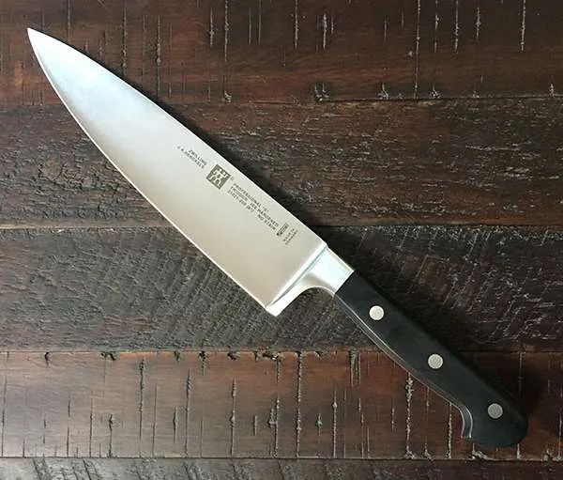
KILL LETTER
THE HELOC IS NOT CLOSED UNTIL THE DOCUMENTATION SAYS IT IS.
Notes:
[Sources]
Source content: 2026 Title Tailgage CLE UW Panel Slides - combined.docx
[/Sources]

Slide 62
TITLE TAILGATE
SCENARIO
The problem here is that there is no written documentation that the HELOC has been closed. We are insuring to the new lender that they have a first priority lien interest in the property. The potential risk is that it remains open with a zero balance and then borrower continues to draw in the future. What might we require to insure?
Notes:
[Sources]
Source content: 2026 Title Tailgage CLE UW Panel Slides - combined.docx
[/Sources]

Slide 63
UNDERWRITING PANEL
Due Diligence
Obtain documentation from HELOC lender with confirmation that the line has been closed.
Obtain a copy of the Owners Title Policy issued at the purchase.
Assuming that a policy was issued, indemnity can be obtained.
Notes:
[Sources]
Source content: 2026 Title Tailgage CLE UW Panel Slides - combined.docx
[/Sources]

Slide 64
UNDERWRITING PANEL
Mutual Indemnity Agreement
Coverage includes unreleased security deeds up to 1million, but not HELOCs. Above this threshold, if the lien is a HELOC or other open-ended revolving credit loan, will require an indemnity letter. Underlying policy must be at least one year old.
Notes:
[Sources]
Source content: 2026 Title Tailgage CLE UW Panel Slides - combined.docx
[/Sources]

Slide 65
NEXT MATCHUP
NOTARY ACKNOWLEDGEMENTS
UNDERWRITING PANEL | TITLE TAILGATE
Notes:
[Sources]
Source content: 2026 Title Tailgage CLE UW Panel Slides - combined.docx
[/Sources]

Slide 66
UNDERWRITING PANEL
Title exam reveals a 2023 vesting deed (QCD) with a notary acknowledgment.
You communicate the issue with the grantee and grantor is deceased.
Notes:
[Sources]
Source content: 2026 Title Tailgage CLE UW Panel Slides - combined.docx
[/Sources]

Slide 67
MAKE THE CALL
What is your call?
INSURE
DON’T INSURE
NEED MORE INFORMATION
VOTE BEFORE THE RULING
Notes:
[Sources]
Source content: 2026 Title Tailgage CLE UW Panel Slides - combined.docx
[/Sources]

Slide 68
TITLE TAILGATE
UNDERWRITING GUIDANCE
An issue typically arises when documents that are to be recorded in Georgia are prepared and executed outside of the state of Georgia.
Two reasons for proper execution of documents.
  First, a document must be in proper form in order for the clerk to record and thereupon provide constructive notice to the world.
  Second, even if the clerk inadvertently records an incorrectly executed document, if the form is not proper, the validity and priority of the document itself can be challenged in bankruptcy or other litigation proceeding.
Notes:
[Sources]
Source content: 2026 Title Tailgage CLE UW Panel Slides - combined.docx
[/Sources]

Slide 69
UNDERWRITING PANEL
Change in Law
An acknowledgement typically states that the person signing the document proved to the notary that he/she was the person who signed the document, but the notary did not necessarily witness that person sign the document.
In the past, Georgia law accepted acknowledgements as long as two unofficial witnesses witnessed the signing.
Under the new law (effective July 1, 2015) acknowledgments are no longer permitted for conveyances relating to deeds to land (e.g., deeds and security deeds).
Examples on next slide
Notes:
[Sources]
Source content: 2026 Title Tailgage CLE UW Panel Slides - combined.docx
[/Sources]

Slide 70
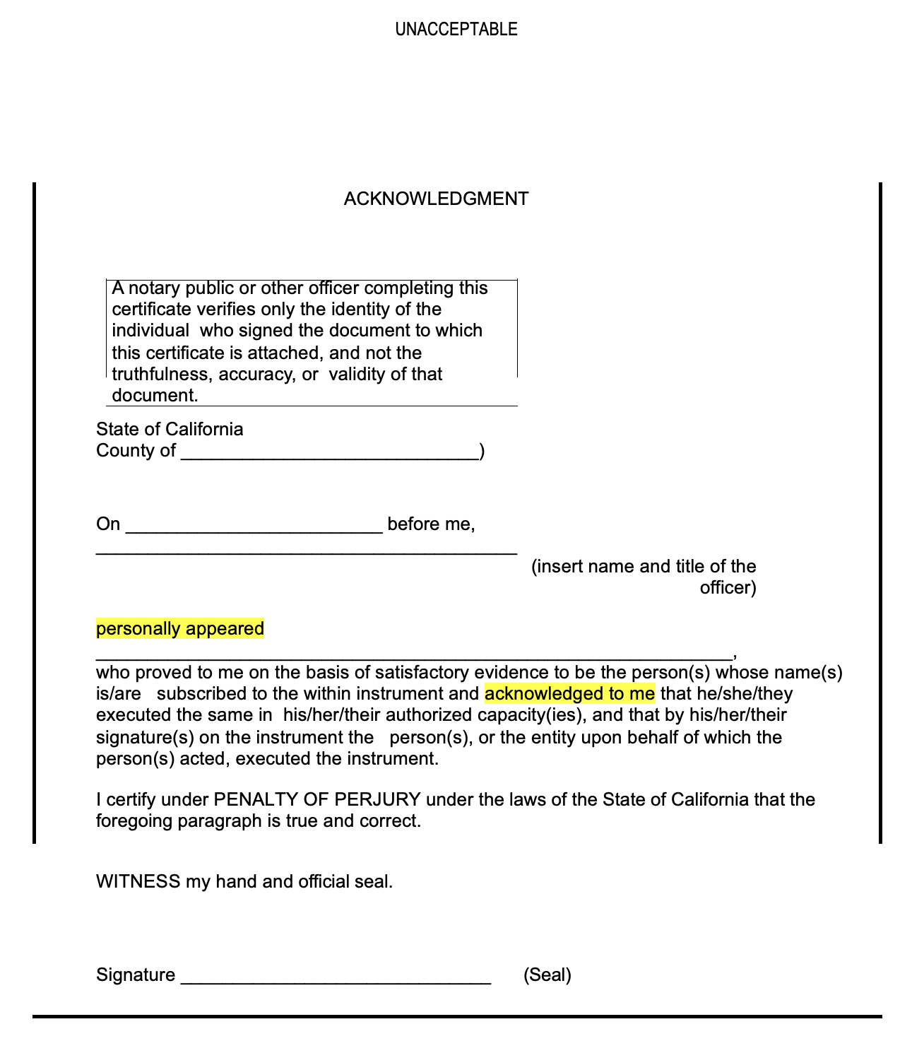
UNDERWRITING PANEL
Notes:
[Sources]
Source content: 2026 Title Tailgage CLE UW Panel Slides - combined.docx
[/Sources]

Slide 71
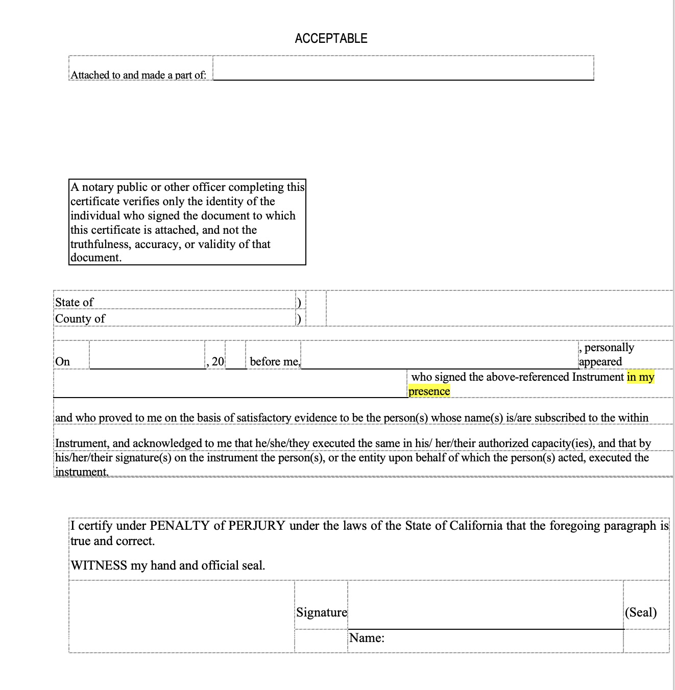
UNDERWRITING PANEL
Notes:
[Sources]
Source content: 2026 Title Tailgage CLE UW Panel Slides - combined.docx
[/Sources]

Slide 72
UNDERWRITING PANEL
SOLUTIONS
First is the cleanest. Have a new deed signed. Typically, these deeds have zero transfer tax/consideration and the parties are some how related to each other.
An affidavit of a third person testifying to the execution of the deed and to the genuineness of the handwriting of the subscribing witness or witnesses shall be sufficient to admit the deed to record. Attach a copy of the original recorded deed as an exhibit to the affidavit.
Notes:
[Sources]
Source content: 2026 Title Tailgage CLE UW Panel Slides - combined.docx
[/Sources]

Slide 73
UNDERWRITING PANEL
Does your answer change if:
This appears to be a death bed deed?
Four weeks after the deed was signed, grantor dies.
Signature is extremely shaky and is completely illegible.
Notes:
[Sources]
Source content: 2026 Title Tailgage CLE UW Panel Slides - combined.docx
[/Sources]

Slide 74
UNDERWRITING PANEL
Food for thought
The question of sound mind comes into play.
There is a potential problem in that there are other heirs are unaware of this deed and have a potential claim to the property if the property is sold by grantee.
More information is necessary. Was there probate? How long ago? Have heirs sign QCDs?
Notes:
[Sources]
Source content: 2026 Title Tailgage CLE UW Panel Slides - combined.docx
[/Sources]

