Slide 1


Slide 2
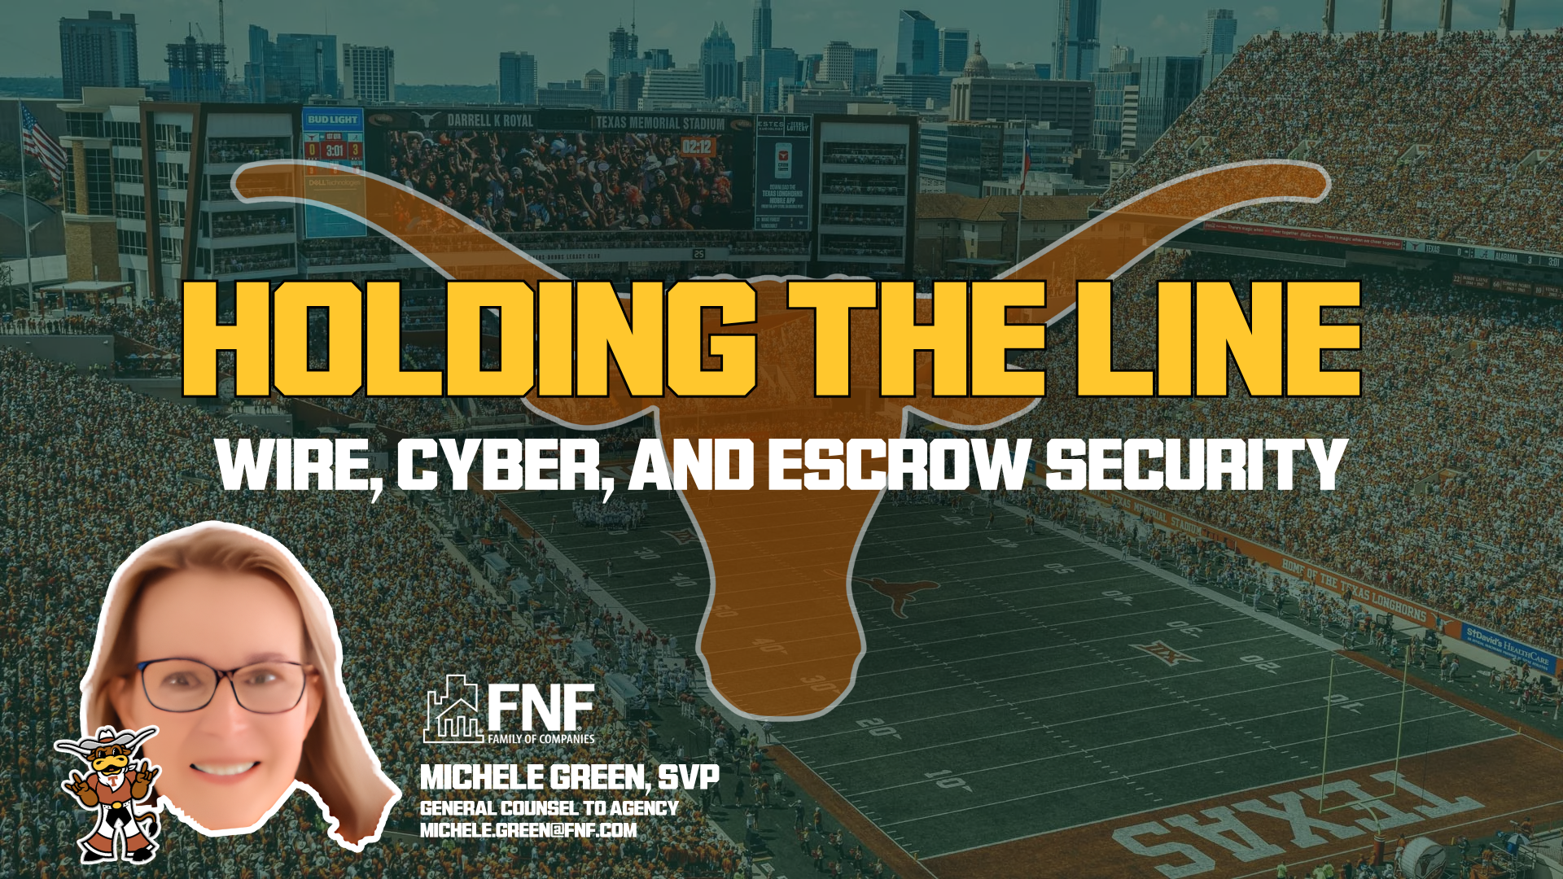

Slide 3



HOLDING THE LINE:
WIRE, CYBER and ESCROW SECURITY
Michele A. Green, SVP
General Counsel to Agency – FNF
Michele.green@fnf.com

Slide 4

Misconceptions Remain
  This won’t happen to me.
  I have insurance for this. Seller Impersonation Fraud isn’t wire fraud, so I have coverage if I have a mail-away forgery.
  If I have a wire fraud incident, I am a victim of fraud.
  I send only checks for mortgage payoffs, so I am safe. I only do in-person closings, so I am safe.
  My processes and protocols will be able to detect and avoid fraud.
  I can trust my employees to follow my protocols every single time.
  I trust seller’s counsel. (When I’m just acting as seller’s counsel, I don’t have to worry about this.)
  I’m sure my systems are secure. I’m sure lender emails are secure.
  I don’t need/can’t afford a solution partner to protect my business.
  All of the solution partners in the market are basically the same.

Slide 5
How to choose?
SOLUTION
PARTNERS FOR
WIRE FRAUD
PROTECTION
Products and Services
Risk Transfer
Insurance
Other Services
Price
Customer Service
Integrations
E&O Discounts

Slide 6
Who is your IT Partner?
You won’t avoid liability if you are the compromised party.
Incoming Wire Fraud (buyer/borrower cash to close)
      You won’t avoid liability if the email to the consumer comes from your network
Outgoing Wire Fraud
      Is someone in your Outlook?
        Checking for “rules”
IT PARTNERS FOR
WIRE FRAUD
PROTECTION

Slide 7

RANSOMWARE
  What does this look like for your business?
  Is it even avoidable?
  How do you react?
  Financial and reputational damage.
  You CAN purchase insurance for this.

Slide 8

THE “LATEST THREAT”
ACCOUNT TAKEOVER FRAUD

Slide 9
ACCOUNT TAKEOVER SOLUTIONS
  This is rampant – Over and over remind yourselves and staff to never give credentials to anyone for any reason.
  Utilize the best IT and security protocols.
  This can be avoided almost all the time with better account security set up with their banks – multi-factor AND multi-party for account security settings changes and for wires.
  These situations are often covered under cyber and/or crime policies (differently than ordinary wire fraud). Agents need to make sure they have the right policies and have enough coverage.
  The right bank can make all of the difference.
  Incident response is vital. So is daily reconciliation.
  AVOIDANCE – LOSS MITIGATION - INSURANCE

Slide 10

Thank you!
Michele A. Green, SVP
General Counsel to Agency – FNF
Michele.Green@fnf.com

Slide 11
Insurance in the World of Wire Fraud
  E&O
    Evolution
    Theft of Funds
    Endorsements
    Exclusions
  Crime/Social Engineering Policies
    Who is the recipient?
    Procedures
  Cyber Insurance
    Were you compromised?
    Exclusions
    Back

Slide 12
AVOIDANCE MEASURES ARE DISTINCT
Each type of wire fraud calls for its own, separate set of defenses — one solution does not cover them all.
Incoming Wire Fraud
Buyer / borrower cash to close. Deliver wiring instructions through secure, verified channels and warn buyers never to trust emailed changes. Liability follows the compromised party and those in a fiduciary capacity who have a duty to warn. Consider providing a safe vehicle for payment.
Mortgage Payoff Wire Fraud
Consult a database of previously safely used wire instructions. Otherwise, verify payoff instructions directly with the lender using independently sourced contact details. Do you have access to account validation technology and a listing of known fraudulent accounts repetitively used by fraudsters?
Seller / Other Outgoing Wire Fraud
Confirm the identity of the party providing wire instructions before releasing funds. Obtain payment directions early and safely. Watch for last-minute changes to disbursement details. Do you have access to account validation technology and a listing of known fraudulent accounts repetitively used by fraudsters?
Seller / Borrower Impersonation Wire Fraud
Be alert for high-risk transactions. Confirm the identity of the seller or borrower with identity-verification tools and independent proof of ownership. Do you have access to AI-detecting identity validation tools? Do you have access to account validation technology and a listing of known fraudulent accounts repetitively used by fraudsters? Do you have access to technology that detects newly created email accounts, burner phones, and geolocates the opening of email addresses?

Slide 13

How AI and Deep Fake Technology Are Changing the Game?
  You can no longer trust your eyes and ears, or even your gut.
  You have to fight technology with technology.
  You don’t need to go back to the 80s with paper checks.
  BACK

Slide 14
BACK
INFORMATION SECURITY & YOUR IT PARTNER
Choose an IT provider with proven experience protecting title, escrow, and settlement firms – not a generalist.
Require multi-factor authentication on email, banking, and every business-critical system.
Keep software, firewalls, and endpoints patched, monitored, and backed up continuously.
Isolate banking to a dedicated, hardened device.
Lock down email forwarding rules.
Train staff regularly to spot phishing, spoofed callers, and credential-theft red flags.
Demand 24/7 monitoring, rapid incident response, and a tested recovery plan from your provider.
Review user access rights and your provider’s security controls on a recurring schedule.
PREVENTION – VIGILANCE – PARTNERSHIP

