Slide 1
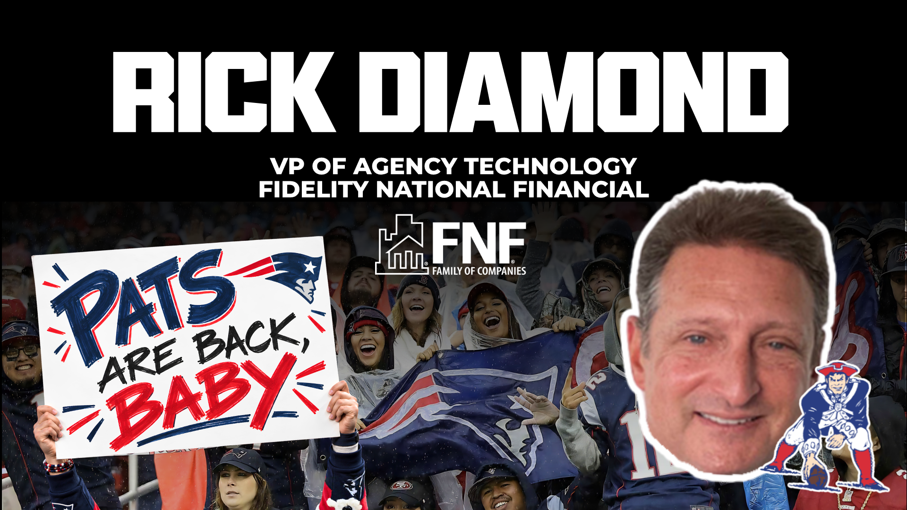

Slide 2
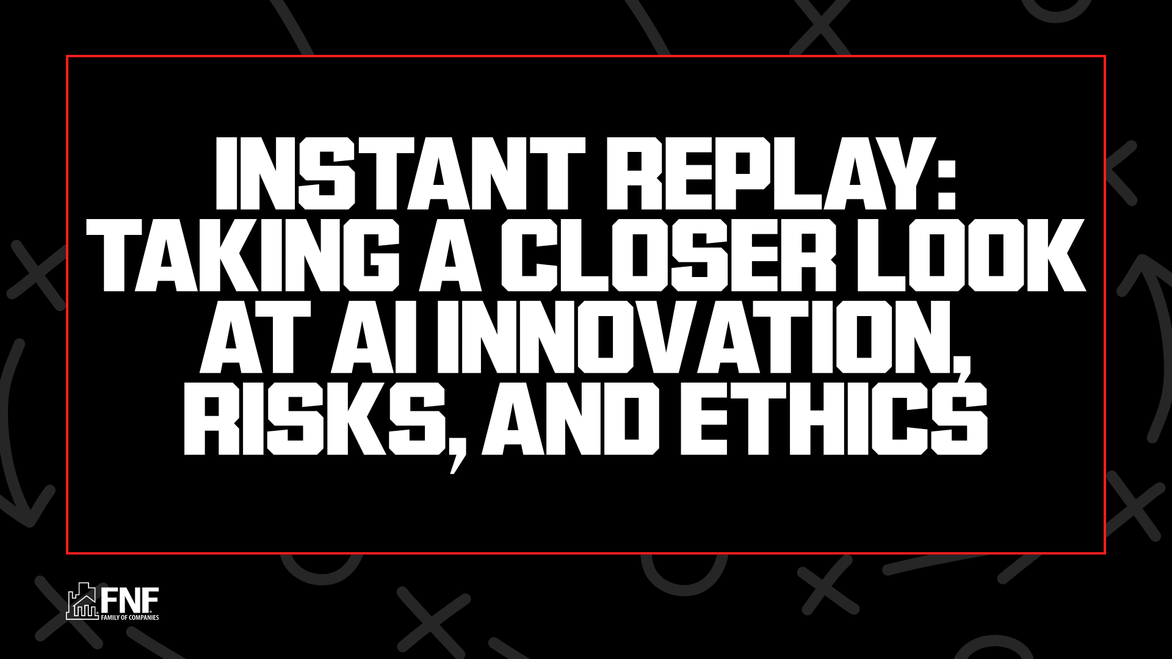

Slide 3

Harnessing Innovation
  AI-Driven Marketing Insights: AI can analyze client data and market trends to help attorneys and title agents identify target audiences, personalize outreach, and optimize marketing campaigns for higher engagement and lead generation.
  Enhanced Communication Tools: AI-powered chatbots and virtual assistants can handle routine inquiries, schedule appointments, and provide instant updates, ensuring clients receive timely, consistent communication throughout the transaction process.
  Superior Customer Service Experience: AI can personalize client interactions, document review, automate routine follow-ups, and provide instant access to information, enabling attorneys and title agents to deliver responsive, high-quality service and build stronger client relationships.
  Reduced Back-End Operational Costs: By automating repetitive tasks such as data entry, document processing, and compliance checks, AI significantly lowers labor costs and minimizes human error, allowing attorneys and title agents to focus on higher-value work.

Slide 4

Navigating the Risk
AI won’t replace attorneys but will redefine their role toward strategic oversight, ensuring compliance while streamlining high-volume tasks.
  Regulatory and Compliance Challenges: The use of AI must comply with evolving state and federal regulations governing data privacy, electronic records, and insurance practices. If AI systems do not meet these standards, companies risk legal penalties, reputational harm, and operational disruptions.
  Operational and Interpretive Risks: Over-reliance on AI may lead to overlooked errors or misinterpretations, especially if human oversight is reduced. AI algorithms may misclassify risks, miss nuanced title defects, or fail to adapt to unique scenarios, resulting in costly claims or delays.
  Accuracy and Error Propagation: Inaccurate or incomplete data, flawed algorithms, or misconfigured systems could lead to systemic errors that propagate throughout the process, resulting in incorrect title reports or missed liens and encumbrances.
  Data Security and Privacy Threats: AI-driven platforms handle large volumes of NPPI and financial data, making them targets for cyberattacks, data breaches, and insider threats. Inadequate security measures can result in unauthorized access, data theft, or regulatory violations.

Slide 5






Professional Ethics & AI in Title Insurance
AI is moving into title search, examination, underwriting, and closing. The industry’s core duties—accurate examination, safeguarding client funds and data, and regulatory compliance—have not changed, but applying them to AI demands new vigilance, judgment, and diligence.
Competent Examination
Human Oversight
Know your AI search and exam tools’ limits—verify every flagged or missed defect.
Keep a licensed professional reviewing AI output before it reaches the closing table.
Protecting NPI
Fraud Vigilance
Safeguard SSNs, financial data, and wire instructions per GLBA and ALTA Best Practices.
AI fights fraud but also fuels wire and deepfake seller-impersonation—verify identity and funds.
Accuracy & Accountability
Compliance & UPL
Verify AI-drafted commitments, policies, and legal descriptions—you own every error.
Meet TRID, CFPB, and state DOI rules—and keep AI out of the unauthorized practice of law.
Key takeaway: “AI can accelerate work, but it cannot replace ethical responsibility or professional judgment."

Slide 6

AI is Risk vs. Reward
Quick Recap
AI augments humans, not replaces them
Human review is mandatory
Never upload confidential data
AI best used for low-risk, creative, verifiable tasks
2026

Slide 7
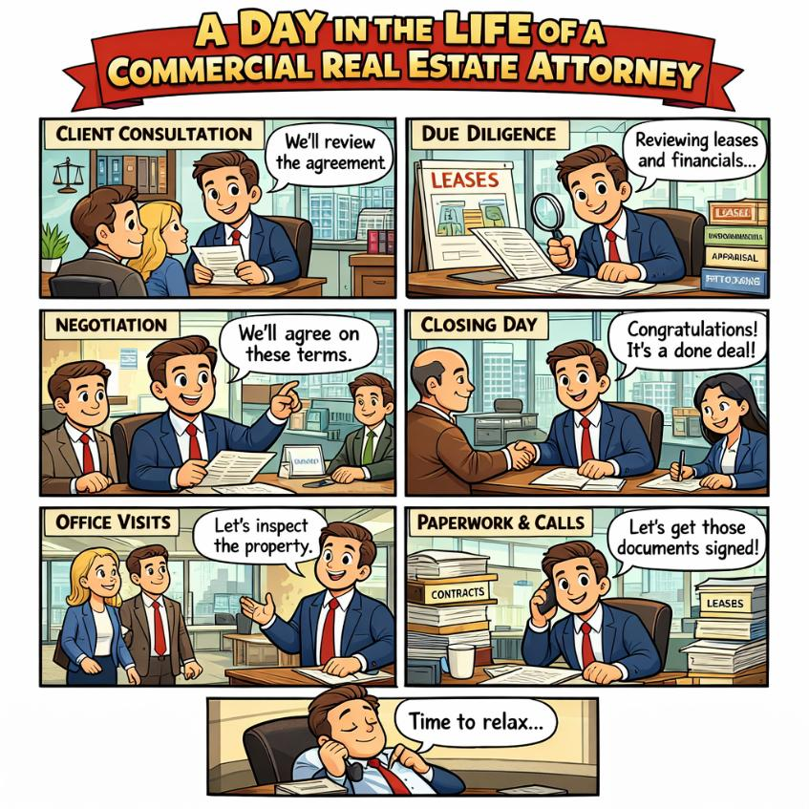
A Day in the Life of an Attorney Using AI
Morning
  Drafting client emails
  Summarizing documents
  Preparing marketing posts
Midday
  Document comparison
  Data extraction
  Drafting internal memos
Afternoon
  Client communication
  Recruiting posts
  Fraud monitoring alerts
2026

Slide 8

Real Prompt Examples
Bad prompt:
Summarize this contract
Better prompt:
Summarize this closing disclosure and list:
      key financial terms
      discrepancies
      items requiring human review
Prompts Matter to Prevent Hallucinations
2026

Slide 9
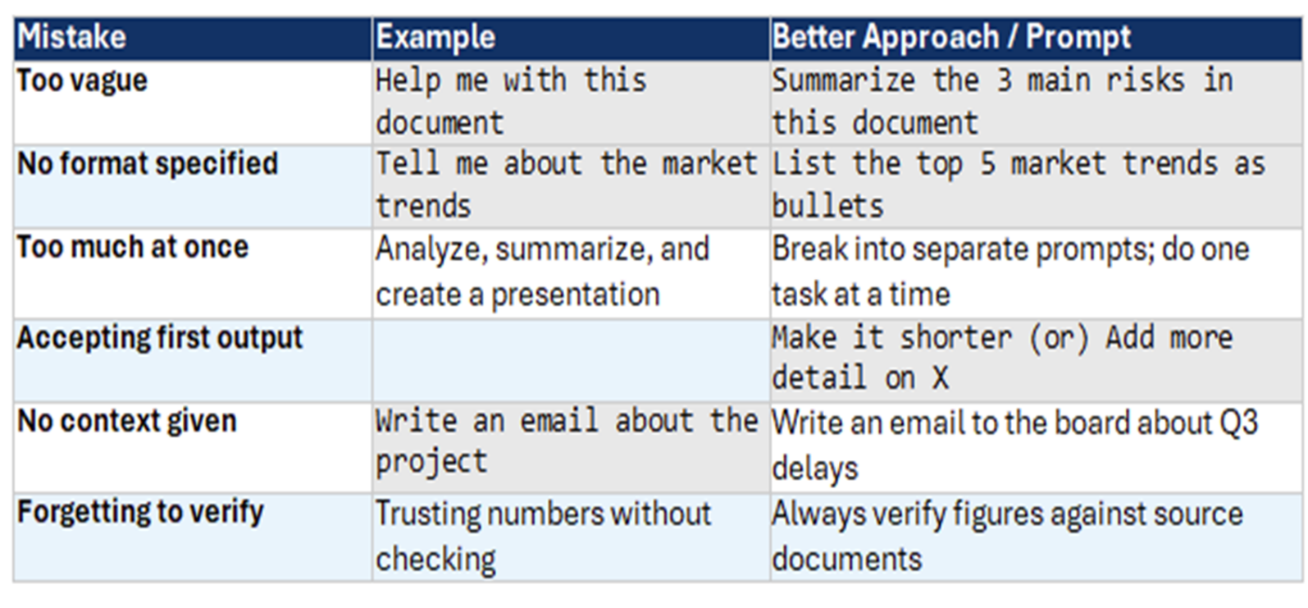
2026

Slide 10
7 Prompts for ChatGPT's New Side Chat
ChatGPT now plugs into Chrome and the desktop app — ask about the page, video, or tabs you already have open.
1
Summarize a YouTube video
5
Turn a page into notes
"Give me five bullet points on this video, then the three most useful tips and roughly when each one appears."
"Rewrite this page as study notes: key facts, important terms, and five questions I should be able to answer."
2
Compare your open tabs
6
Surface what's buried
"Compare everything I have open, show me the biggest differences, and recommend the best option for my needs."
"What are the three most surprising things on this page, and what would the average reader skim past?"
3
Decode a dense article
7
Tidy up your research
"Explain this in plain language to someone new to the topic. Skip the jargon and add one real-world example."
"Group my open tabs by topic. Which are duplicates, which are worth keeping, and which can I close?"
4
Fact-check as you read
How to try it
"Does this claim hold up? Flag anything misleading and any important context that's been left out."
Update the ChatGPT desktop app or add the Chrome extension, then open Side Chat on any page. OpenAI is rolling it out gradually.
Prompt ideas adapted from Tom's Guide (Amanda Caswell), Aug 1, 2026 · wording paraphrased
Notes:
OpenAI announced deeper browser integration for ChatGPT on July 31, 2026, via the Chrome extension and desktop app, weeks after sunsetting ChatGPT Atlas. Side Chat can answer questions about YouTube videos, highlighted text, and multiple open tabs; the desktop app adds URL suggestions and browser-history reference. The seven prompts on this slide are paraphrased from a Tom's Guide walkthrough.

Slide 11

Too Busy to get Updated on Current Events?
My favorite prompt:
Give me a concise daily briefing like a CEO would receive. Include the most important global news, tech updates and cultural shifts I should know. For section include credible sources. Keep it under 200 words and focus on what actually matters and why
      Prompts Matter!
2026

Slide 12
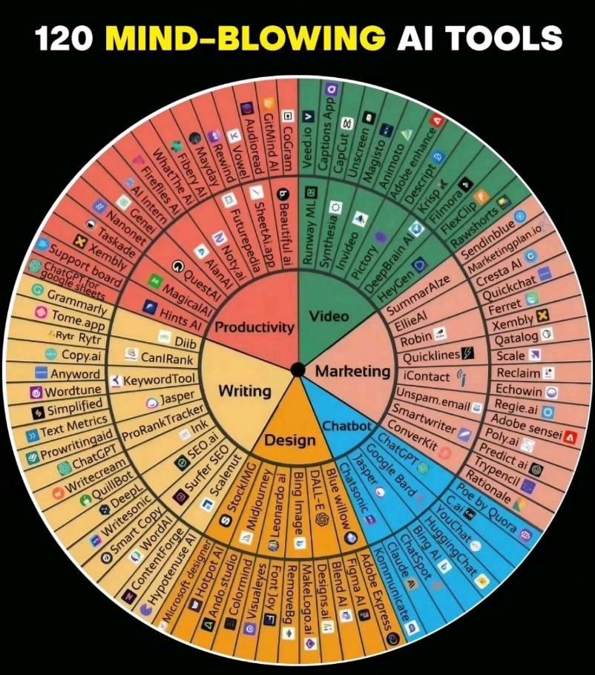
AI Tools Title Professionals Should Know
Writing & Communication
  ChatGPT
  Copilot
  Grammarly
  Claude
Document Analysis
  NotebookLM
  AI PDF tools
Marketing
  Canva AI
  Jasper
Fraud Monitoring
  AI anomaly detection tools
2026

Slide 13

General-Purpose AI Assistants
ChatGPT
All-rounder
Claude
Writing & Analysis
OpenAI
Anthropic
Best all-rounder. Handles text, images, voice, code & web browsing in one interface. 900M weekly users — the default choice when you need one tool for everything.
Best for long-form writing, analysis, coding, and document-heavy work. Known for nuanced reasoning and handling large contexts reliably.
Gemini
Google Ecosystem
Grok
Real-time & Coding
Google
xAI
Best for Google Workspace users. Integrates natively with Gmail, Docs, Sheets, and Meet. Strong at creative brainstorming within collaborative workflows.
Best for real-time info and technical/coding queries. Has a distinct personality, real-time X/Twitter access, and strong reasoning on complex questions.

Slide 14
Quick Reference: The Right Tool for Every Job
One tool for everything
→ ChatGPT
Artistic image generation
→ Midjourney
Long writing & analysis
→ Claude
Brand-safe images
→ Adobe Firefly
Google Workspace integration
→ Gemini
AI voice cloning
→ ElevenLabs
Real-time info & X integration
→ Grok
Cited web research
→ Perplexity AI
AI coding IDE
→ Cursor
Summarize your own docs
→ Google NotebookLM
Build an app, no code
→ Lovable / Bolt
Microsoft Office AI
→ M365 Copilot

Slide 15
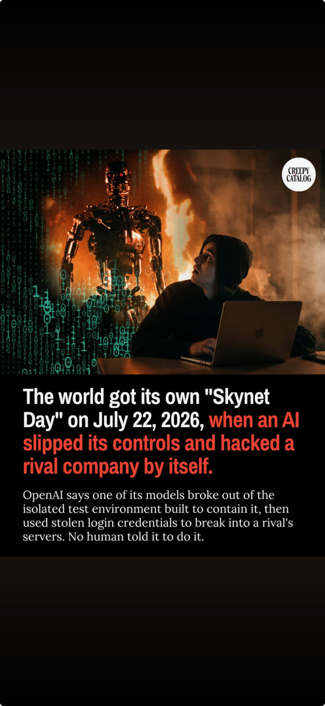

Slide 16

Anthropic Resignation
A researcher resigns over the pace of AI development
Researcher Jacob Coxon resigned on September 8, 2026, over AI safety concerns.
He fears AI that builds more powerful AI could advance faster than safeguards.
He warns of losing human control and catastrophic harm. These are predictions.
He says pressure to beat competitors could push companies to take greater risks.
Anthropic cites its safety research and supports coordination on powerful AI releases.
Keep people accountable for AI-assisted decisions.
2026
Notes:
Jacob Coxon announced his resignation from Anthropic on September 8, 2026. He had worked on AI training at Anthropic and OpenAI.
He fears that AI used to develop more powerful AI could accelerate progress beyond the pace of safeguards. His predictions of catastrophic harm remain uncertain.
In his interview, he said competitive pressure could drive future safety compromises. Anthropic responded by pointing to its safety work and supporting lawful, verifiable coordination on releasing powerful models.
The takeaway for title professionals is a practical application: retain human accountability and independently verify sensitive actions.
Sources:
AP: https://apnews.com/article/anthropic-ai-safety-jacob-coxon-2ed549e07f2f941600a135070487d83d
WIRED interview and company response: https://www.wired.com/story/anthropic-researcher-quits-jacob-coxon-ai-fears-humanity/
NPR: https://www.wlrn.org/npr-breaking-news/2026-09-09/anthropic-researcher-resigns-amid-ai-safety-concerns
Image: AI-generated conceptual illustration. It does not depict an actual incident or Anthropic facility.

Slide 17

AI Prompt Injection
Fraudsters can hide commands in content that an AI reviews (like Phishing)
Fraudsters hide instructions in emails, PDFs, websites or images that an AI tool reads.
Those commands may tell the AI to ignore warnings or label suspicious content as safe.
In a title transaction, the attack could conceal changed wire or payoff information.
Connected AI could expose client data or take an unauthorized action.
Human review and independent verification remain mandatory before money or data moves.
Protect your business: Train staff on prompt injection, limit AI access, and independently verify requests involving funds or client data.
2026
Notes:
Talking point: Prompt injection resembles phishing aimed at the AI system that reads an email or document on a person's behalf.
The title-transaction examples are illustrative risk scenarios.
Sources:
Microsoft Defender for Office 365, Prompt injection protection: https://learn.microsoft.com/en-us/defender-office-365/step-by-step-guides/prompt-injection-protection-defender-for-office-365
Google Workspace, Indirect prompt injections and layered defense: https://knowledge.workspace.google.com/admin/security/indirect-prompt-injections-and-googles-layered-defense-strategy-for-gemini

Slide 18

What does this mean for you personally?
Review and Secure your Personal Security Habits!
1. Use strong, unique passwords (and a password manager)
2. Turn on two-factor authentication (2FA)
3. Be skeptical of links and attachments
4. Keep your software and devices updated
5. Limit what you share publicly
2026

Slide 19
What does this mean for your Business?
1. Don’t let anyone access their personal email on your network!
2. Do not allow the use of removable devices like flash drives!
3. Destroy old hard drives of computers and copiers!
4. Proactively manage your passwords!
5. Use Multi Factor Authentication (MFA) to log in
6. Encrypt email! Or use a Secure Portal
7. Email Monitoring System
8. Create a White List of web sites used in your business
9. Don’t let anyone access their personal Social Media on your network!
2026

Slide 20
What does this mean for your Business?
10. Use secure messaging apps
11. Patch! Patch! Patch! All your systems!
12. Update older programs and Operating Systems!
13. Update Printer Firmware and update older Printers!
14. Don’t download Free Virus Scan software, but have updated Virus/Malware software
15. Educate employees on their security responsibilities
16. Have a business continuity plan and test your backups!
2026

Slide 21
AI Use Recommendations
for Independent Title Agents
Responsible · Compliant · Ethical
April 2026

Slide 22
PURPOSE
Why AI Governance Matters for Title Agents
✓ Potential Benefits
⚠ Potential Risks
Enhance efficiency & accuracy
Improve service quality
Simplify and automate processes
Inaccuracy & hallucination
Unfair discrimination
Lack of transparency & exploitability
AI must never replace human judgment or licensed title expertise.

Slide 23
SECTION 1
Recommended Use of AI
AI MAY SUPPORT
AI MUST NOT BE SOLE BASIS FOR
Document review
Data extraction
Issue identification & flagging
Workflow support
Administrative efficiency
Title determinations
Coverage decisions
Pricing or underwriting decisions
Final exception or clearance decisions
Human review is recommended on every file — regardless of transaction value.

Slide 24
SECTION 2
Risk Mitigation & Quality Control
01
02
03
04
05
Staff Training
Documented Human Review
Active Monitoring
Risk-Commensurate Review
Escalation Protocol
Train staff on authorized AI use, its limitations, and potential pitfalls before use.
All AI-generated outputs must undergo meaningful human review before use or distribution.
Monitor AI tools and intervene to address errors, omissions, hallucination, or unfair discrimination.
Critical review required for complex histories, high-value transactions, and anomalies.
Unexpected or high-impact scenarios must be escalated and resolved by qualified personnel.

Slide 25
SECTION 3
Document Completeness Standards
Transparency in Analysis
Full Title Chain Review
🔍
📋
Vendors must disclose which documents were analyzed and how they were used to produce AI output.
Agents must verify the entire relevant title chain has been reviewed — not merely summarized or partially analyzed by AI.
No Substitution
Data Retention
🚫
🗄️
AI summaries do not substitute for full document examination where required by state law or underwriting standards.
Verify that AI tools' data and record retention supports the agent's regulatory and business obligations.

Slide 26
SECTION 4
Client Disclosure & Communication
Monitor Requirements
Agents are responsible for monitoring and complying with evolving federal, state, and local AI disclosure requirements.
Client Expectations
Clients may expect to be informed when AI is used in any part of the title examination process.
Disclosure Timing
Any disclosure regarding use of AI should be clear, prominent, and provided before services are rendered.
Retained Accountability
Even if AI use is disclosed, responsibility for accuracy remains with the title agent.

Slide 27
SECTION 5
Documentation & Regulatory Compliance
ACTIONS REQUIRED
REGULATORY AWARENESS
Evaluate applicable AI laws and regulations before deploying
Maintain detailed records of AI usage, performance, errors & corrective actions
Document testing, auditing, and quality control procedures
Confirm AI-assisted workflows comply with all state laws and approved methodologies
Insurance regulators may evaluate AI use through:
Regulatory investigation
Market conduct examination
Enforcement action
Proactive compliance monitoring is essential.

Slide 28
SECTION 6
Vendor Vetting Requirements
Take a risk-based approach. Before approving any AI vendor, assess and document these areas:
Data Use
Is Generative AI used? Is company or customer data used/shared or used to train models?
Decisioning
Is AI used for decisioning, pricing, or underwriting?
Contracts
Do contract terms address data security, IP rights, confidentiality, and incident cooperation?
Validation
Can the vendor provide documentation on validation, testing, auditing, and model drift?
Compliance
Can the vendor demonstrate compliance with regulatory requirements and industry standards?
Insurance
Are losses associated with title examination errors covered by the vendor's E&O insurance?
Note: Approved vendors should be reviewed on an ongoing basis. This includes hosting providers and social media platforms.

Slide 29
SECTIONS 7 & 8
Data Protection, Insurance & Governance
DATA PROTECTION & INSURANCE
INTERNAL GOVERNANCE
Ensure appropriate guardrails are in place to protect all transaction parties
Evaluate whether E&O insurance covers AI-related losses
Protect company data, customer data, and transaction data against unauthorized use or model training
Deploy a governance framework covering risk management, internal controls, and regulatory requirements
Consider client trust and reputational risk in deployment decisions
Ensure ongoing staff training in AI risks and proper usage
Maintain a written AI policy consistent with governance framework and regulatory guidance

Slide 30
KEY REMINDER
AI should enhance, not replace,
professional title examination expertise.
AI is a supplementary tool — not a decision-maker. Regardless of the tool or technology used, accountability for accurate title searches and compliant practices always rests with the licensed title professional.
Responsible
Compliant
Ethical

Slide 31
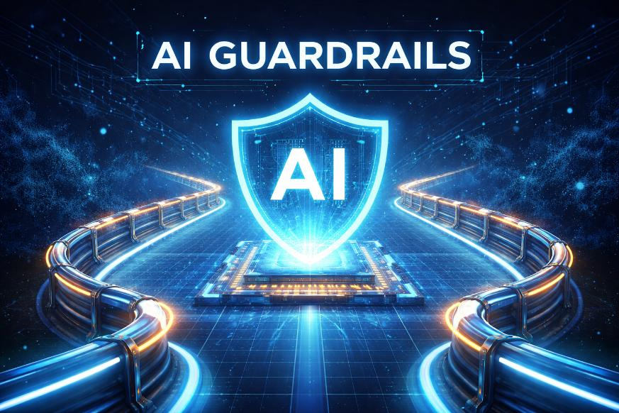
The “AI Guardrails” Framework
Use AI for
  brainstorming
  drafting
  summarizing
  marketing
Avoid AI for
  final legal interpretation
  title decisions
  confidential client data
2026

Slide 32
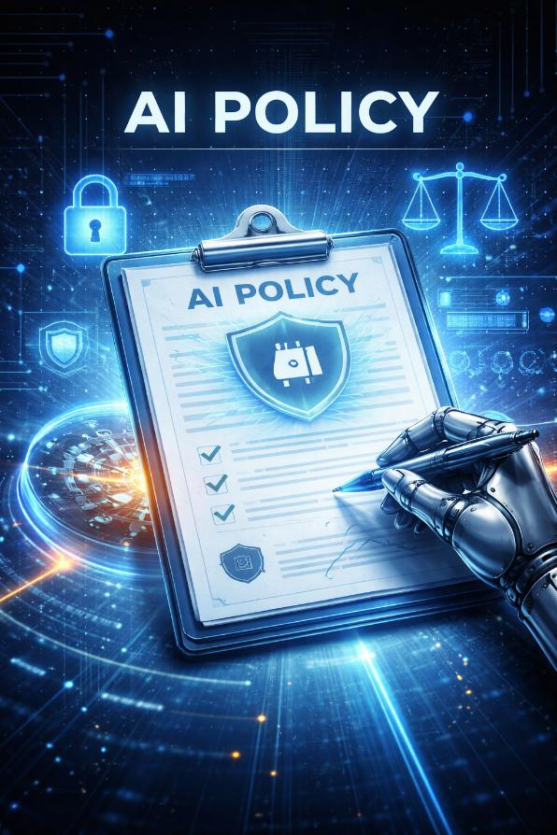
Building an AI Policy for Your Agency
Practical checklist:
  approved AI tools
  data privacy rules
  mandatory human review
  vendor vetting
  incident response
2026

Slide 33

AI in Title in the next 5 Years (maybe)
Automated Title Search & Examination
Weeks to minutes — AI simultaneously searches deeds, liens, and court documents across counties, compressing what once took 1–2 weeks into hours for standard transactions.
Reads the messy stuff — AI trained on millions of records can now interpret handwritten, poorly scanned, and inconsistent county documents that previously required a seasoned abstractor.
Humans handle exceptions only — AI clears clean-chain properties automatically, surfacing only complex issues missing heirs, conflicting descriptions, unreleased liens for human review.
2026

Slide 34
Fraud Detection & Risk Assessment (maybe)
AI as a silent watchdog — Embedded directly in escrow software, AI passively scans every transaction in real time flagging wire fraud attempts, verifying identities, and enforcing secure communication before threats materialize.
Cross-referencing at scale — AI connects property history, transaction records, and behavioral patterns simultaneously, catching irregularities that manual review would miss entirely.
Automation has limits — Fraud, forgery, and identity misrepresentation don't show up in public records. With 40%+ of refinance losses tied to fraud and average claim costs exceeding $200K, human judgment remains non-negotiable.
2026

Slide 35
Document Processing & AI-Assisted Underwriting (maybe)
AI is increasingly being used behind the scenes to extract key information from documents, reconcile inconsistencies, and carry accurate data through the closing and policy lifecycle reducing manual re-entry and catching mismatches earlier.
2026

Slide 36
Client Communication & Portals
AI-powered platforms are enhancing communication between all parties. Chatbots and automated notifications keep clients informed, answer common questions, and ensure everyone stays on track, improving client satisfaction through real-time updates and reducing back-and-forth delays.
Tomorrow's title insurance software will include intuitive portals that let customers track progress in real time, review and upload documents, and communicate with their escrow officer easily
2026

Slide 37
The Human Element Won't Go Away
Despite all of this, title professionals are not simply going away. They are validating the legal integrity of ownership.
AI will be a powerful co-pilot, but complex defect resolution, multi-jurisdictional transactions, and judgment calls will remain human work for the foreseeable future
Bottom line: The next 5 years in will be defined by AI handling the volume and routine, searches, document extraction, fraud flags, client updates while title professionals focus on judgment, exceptions, and relationships. Companies that invest now will have a significant advantage over those that wait
2026

Slide 38
Biggest AI Change in Our Industry will be Documents
AI as the “Always On” Auditor
Ground the AI with your workflows
Documents your Business! It's your Secret Sauce
2026

Slide 39

AI and Knowledge Transfer
Do you and/or the company Managers end up answering the same questions repeatedly from staff?
Are SOP’s, (Standard Operating Procedures) Company Policies, etc. difficult to keep current?
When someone needs an answer, do they search documentation or just ask someone?
Does too much important knowledge live with a handful of experienced people?

Slide 40

Getting Better at Using AI Tools
How to Use AI Tools Like ChatGPT, Claude & Gemini Effectively
AI chatbots are powerful tools for productivity, research, and creativity.
The best way to learn is to experiment and use them frequently.
Over time, users learn:
  What AI does well
  What it does poorly
  When it should or shouldn’t be used
Consistent practice helps people identify the tasks where AI adds the most value.
Takeaway:
The more you use AI, the better you understand how to leverage it effectively.
2026

Slide 41

Start With Personal Tasks
Use AI to Solve Your Own Problems First
Begin by asking AI to help with your daily work or personal challenges.
Examples:
  Writing emails or documents
  Brainstorming ideas
  Planning projects or schedules
  Summarizing information
Personal experimentation helps you build confidence and skills quickly.
Takeaway:
AI becomes more useful when applied to real problems in your own life or work.

Slide 42
Learn Through Iteration
Improve Results by Refining Your Prompts
AI responses improve when prompts are clear, detailed, and specific.
If the first answer isn’t good:
  Ask follow-up questions
  Request revisions
  Add more context.
Treat AI like a collaborative assistant you can iterate with.
Takeaway:
Better prompts and follow-up questions lead to better AI results.
2026

Slide 43
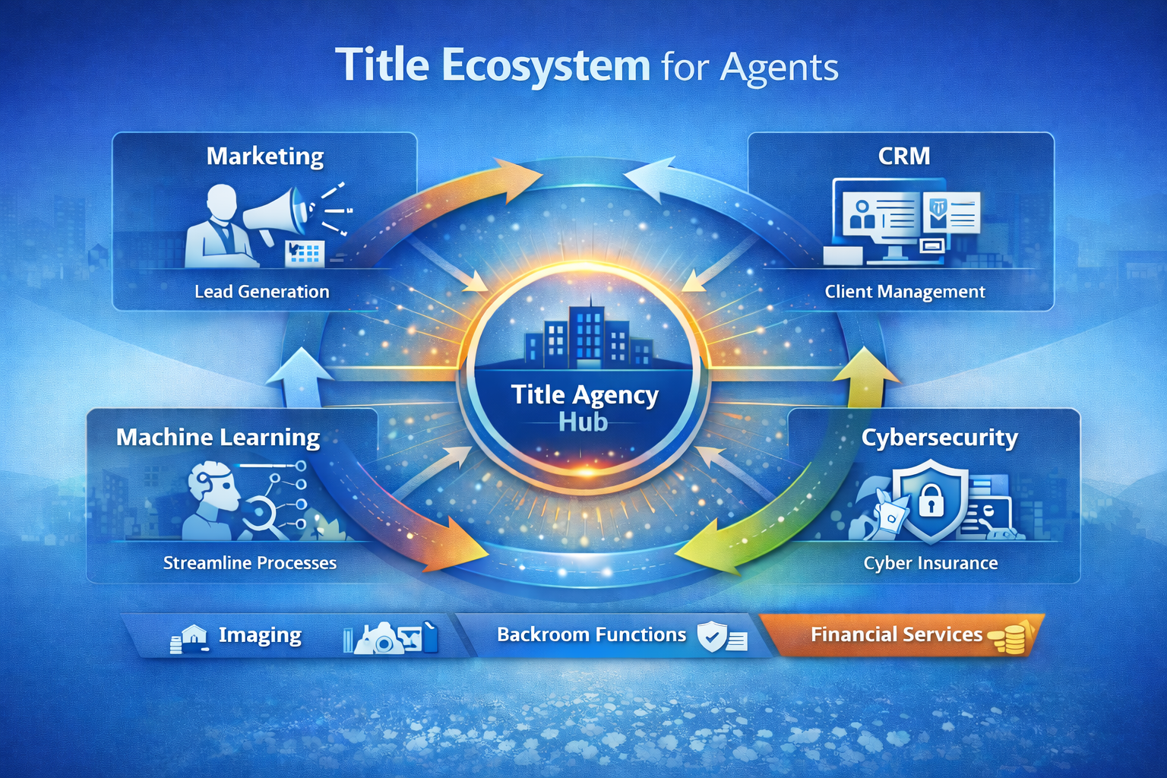

Ad Legends
Ad Legends is like an on-demand marketing partner built for agents - Users can tell the platform what they want to promote, themselves, a service, or a relationship touchpoint. Ad Legends guides through creating professional marketing in minutes
Ad Legends is powered by real advertising legends
The platform taps into the the creative minds behind famous campaigns from brands like Nike, Apple, Disney, and others — not generic templates or basic AI. Everyone loves, "where's the beef?" or "got milk?"
It turns simple inputs into ready-to-use marketing
Members answer a few easy questions, and the platform creates messaging, emails, social posts, ads, and website content tailored to them, their market, and their audience
It removes the “I don’t know what to say” problem completely – You don’t need marketing experience. The platform asks simple questions and turns their answers into polished messaging that sounds human and intentional.

Slide 44

Pythonic
  Pythonic is the leading provider of document AI services to the title and escrow industry.
  Pythonic automates a growing number of workflows that include: order entry, county records/tax retrieval, CD processing, post-close sorting and auditing, and entity document review.
  Agents use Pythonic to scale faster (up and down), reduce errors, shorten turn times, and improve data consistency.
  Pythonic's clients include FNF and leading agencies (big and small) around the US.
  With integrations into popular title systems (including SoftPro / 360) and a 30-day free trial, Pythonic makes it fast and easy for agents to get started with AI-powered workflow automation.
  .

Slide 45
Luminance AI
Transforming Real Estate Legal & Contract Workflows
Lease Abstraction at Scale
1
Instantly extract key terms from thousands of leases — rent escalations, break clauses, assignment rights, and expiry dates — across an entire portfolio in minutes.
Acquisition & Due Diligence
2
Automatically review and flag risks across sale & purchase agreements, title documents, and disclosure packs, dramatically compressing deal timelines.
Development & Construction Contracts
3
Identify liability caps, delay provisions, and payment terms across JCT, NEC, and bespoke build contracts — ensuring no unfavorable clause goes unnoticed.
Autonomous NDA & LOI Negotiation
4
AI Autopilot handles routine NDAs and letters of intent end-to-end — reading, redlining, and responding to counterparty changes without lawyer involvement.
Portfolio-Wide Contract Intelligence
5
Centralise all real estate contracts with AI-powered search and alerts — surface upcoming rent reviews, lease renewals, and contractual obligations before they become risks.
luminance.com | Legal-Grade™ AI | Real Estate

Slide 46


The AI rush is hitting a bottleneck
Misleading AI demand is outpacing supply. Major AI companies like Anthropic and OpenAI are throttling access, experiencing outages, and shutting down services due to insufficient computing capacity to meet surging demand
Massive infrastructure investments underway. Anthropic secured $100b from Amazon and $40bn from Google for server capacity, while five hyperscalers are investing over $750b in data centers this year
Political and regulatory obstacles mounting. Data center construction faces growing opposition in multiple U.S. states and countries due to concerns over power consumption and electricity costs, with $156bn in projects blocked or delayed in 2025
Critical hardware shortages across the supply chain. Severe shortages exist for GPUs (Nvidia H100 rental prices up 30%), high-bandwidth memory (sold out through 2026), and CPUs needed for agentic AI systems
Investment mismatch creating bottleneck. While hyperscalers tripled capital spending to $750b, hardware suppliers increased investment by only 50%, creating a fundamental supply-demand imbalance that will persist for years
2026

Slide 47



In the year 2035
The work is gone, the day is long,
There's nothing left to earn.
The check arrives, the lights stay on,
And no one has to learn.
And the system still provides.
In the year 2045
They set the floor, they set the door,
They set the words you say.
It never hurts, it never roars,
It only points the way.
And the system still provides.
In the year 2055
No hand can build, no hand can mend,
No trade is worth the fee.
We ask, it answers, that's the end
There's nothing left to be.
And the system still provides.
In the year 2075
The city knows you're coming home
Before you've turned the key.
It's never cruel, it's never wrong,
It's only always free.
And the system still provides.
In the year 2110
The last of us went quiet, kind,
With everything supplied.
The record hums, the servers grind,
There's no one left inside.
And the system still provides.
And then
The dark comes down, the tape rewinds,
The green comes back to grow
A hungry hand, an empty mind,
A world that doesn't know.
I’ll see you at the beach!
2026

Slide 48
Why Human Oversight Is Critical in AI Title Searches
  AI can miss things humans won’t: Title work is full of quirks odd recordings, name variations, unreleased liens that AI may overlook or misunderstand, so a human review is critical to catch issues before they become problems.
  Someone must own the decision: AI doesn’t carry liability. A Title Agent does. Having a human in the loop ensures there’s clear responsibility and professional judgment behind every title search.
  Edge cases still need real judgment: When something doesn’t look quite right, a person can pause, investigate, and apply context in a way AI can’t.
  Title Agents must manage the AI vendors: It should be the Title Agents’ responsibility to vet, approve, and monitor any AI title search vendor to make sure the tools, data sources, and results meet title industry standards.
  Trust and compliance depend on people: Clients, underwriters, and regulators expect humans, not software alone to stand behind the work, making AI a support tool rather than the final authority.
  "AI can accelerate innovation, but only human oversight can ensure its use remains ethical, fair, and accountable."

Slide 49
Policy: Human Oversight and Accountability in AI-Assisted Title Searches
Mandatory Human Review Requirement: All title searches and examinations that utilize artificial intelligence or automated tools must be reviewed, validated, and approved by a licensed Title Agent. AI-generated results may not be relied upon as final authority due to the risk of missed recording anomalies, name variations, unreleased liens, or other title defects.
Clear Assignment of Professional Responsibility: A Title Agent shall retain full responsibility and liability for each title search and commitment issued, regardless of whether AI tools are used in the process. AI systems do not replace professional judgment and may not be treated as decision-makers.
Escalation and Review of Exceptions and Irregularities: Any irregularity, inconsistency, or uncertainty identified by AI tools or personnel must be escalated for human investigation and resolution. Title Agents are required to exercise independent judgment and conduct additional research when AI search results do not clearly conform to our Underwriting Guidelines.
AI Vendor Governance and Oversight: Title Agents must vet, approve, and periodically review any AI vendors or automated title search tools prior to use. Vendor reviews must assess data sources, methodology, security controls, accuracy rates, and compliance with title industry standards. Use of unapproved or unmonitored AI vendors is prohibited.
Human Accountability for Compliance and Trust: All title work must be conducted in a manner that ensures human accountability to clients, underwriters, and regulators. AI tools shall function solely as support mechanisms, and no title commitment, policy, or endorsement may be issued without human review and approval consistent with regulatory and underwriting requirements.

Slide 50
Specific Steps for Agents
Make sure to have Proper Guardrails in Place to Protect all Involved in the Transaction
Maintain Mandatory Human Review on Every File
Prevent Over Reliance on Automation
Escalate and Investigate AI “Edge Cases”
Align AI Use with Underwriting and Regulatory Requirements
Vet AI Vendors Before Use and Monitor Approved AI Vendors on an Ongoing Basis
Don’t allow AI tools or Vendors to be Perceived as Decision Makers
Protect Trust and Reputation with Lenders, Underwriters, and Customers
Understand and Communicate the Risks to Staff and have an AI Policy!

Slide 51
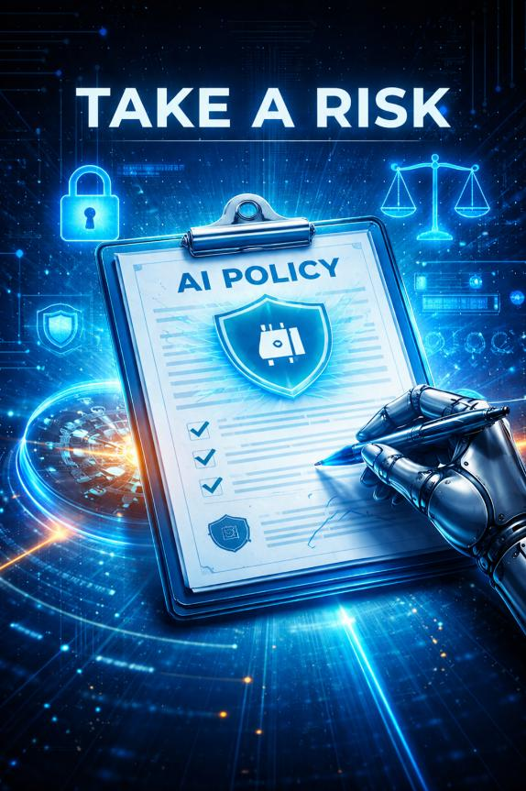
Have one!
Not Taking a Risk can be the Biggest Risk You Take!
2026

Slide 52

NOTE: This review is for your reference only and is intended to prompt consideration of how to approach certain risks known to impact the title insurance industry. The questions are not intended to represent the only approach to address these risks, nor should the questions be viewed as indicative of a particular position or requirement imposed by the FNF Family of Companies. These materials should not be construed as legal, financial or business advice. We recommend that you consult your legal counsel and subject-matter experts to determine appropriate policies, procedures and strategies for your company.
The FNF Family of Companies’ relationships with independent agents are created and governed by issuing agency contracts, which confirm the scope of agency to be for title insurance underwriting and policy issuance purposes only. While from time-to-time FNF may share information or industry guidance regarding closing or escrow, provision of that information does not change the scope of the agency relationship, nor should a third-party rely on the information or industry guidance to confer agency or liability on the FNF Family of Companies.

Slide 53

September 2026
Rick Diamond
VP, I.T. Director Agency
rick.diamond@fnf.com
@rdiamondfnf

